Slide 1
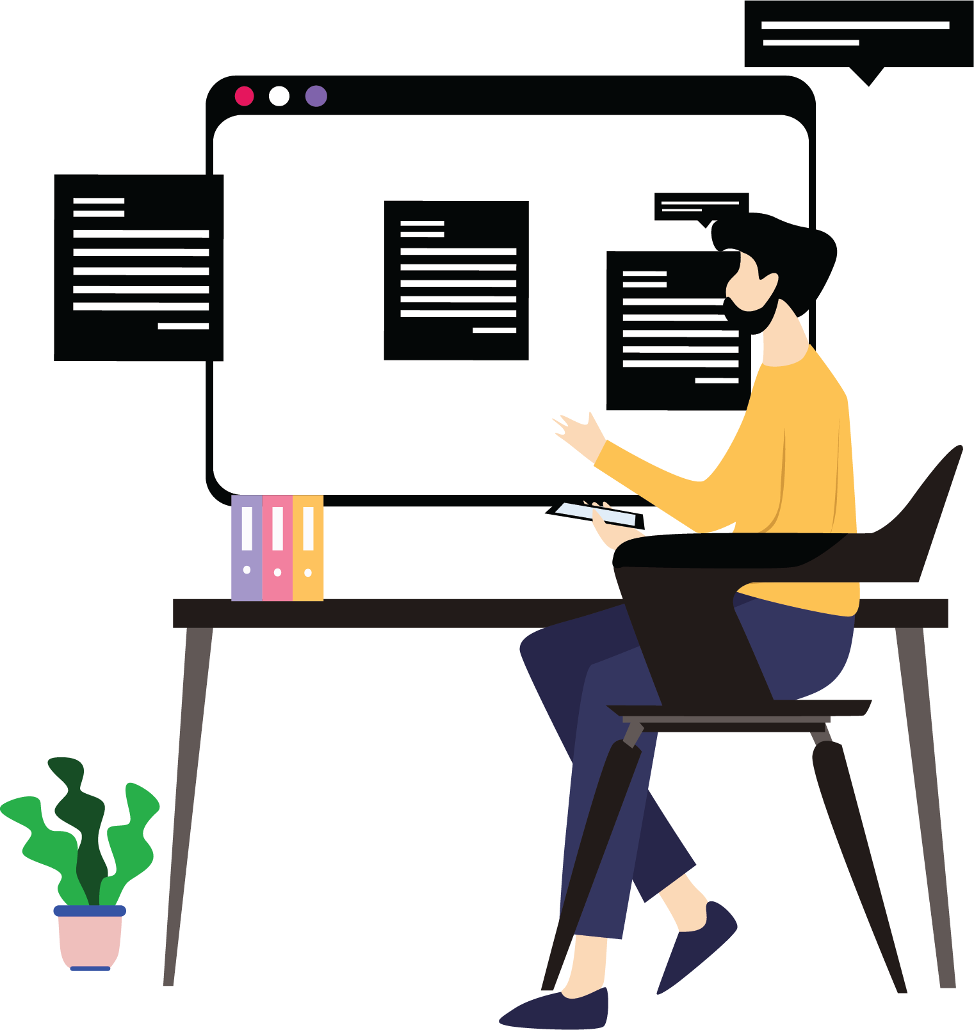
Capstone Project – To-Do Tracker

Slide 2
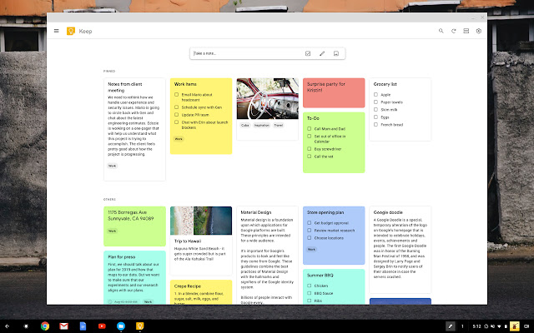
To-Do Tracker
Captures quick ideas, add images to notes, check tasks off your To-Do list, and much more.
One of the fundamental features for any productivity tool is a To-Do list. With the To-Do Tracker, you can create and share notes and lists.
The To-Do Tracker helps you to accomplish a set of tasks in order to achieve a goal wherever you are. In today’s world, many of us, use apps on our phones to manage our tasks. To-Do Tracker surfaces the right tasks at the right time, so you always know what to focus on next.
https://chrome.google.com/webstore/detail/google-keep-notes-and-lis/hmjkmjkepdijhoojdojkdfohbdgmmhki

Slide 3
Project Requirements

Slide 4
What Can a To-Do Tracker Do?
Add and categorize tasks
A task can be added and categorized.
Get a clear overview of all your tasks and never lose track of any important task.
Organize your tasks
Create a list of tasks and due dates by which they need to be completed.
Tag a specific high priority task from the list of tasks you have at hand.
Get reminded about self-imposed deadlines.
Check to enlist the tasks for a particular day.

Slide 5
What Can a To-Do Tracker Do? (contd.)
Modify the tasks as required.
Update a task that needs to be change.
Remove the task completed from the list.
Completed tasks can be ticked off or deleted.
Offer user friendly interfaces.
The To-do tracker provides a well-designed UI to fit into your workflow so you can get back to what you're supposed to be doing.
Archive tasks
Hide the tasks that are completed.
List the archived tasks as and when required.

Slide 6
Work Planning

Slide 7
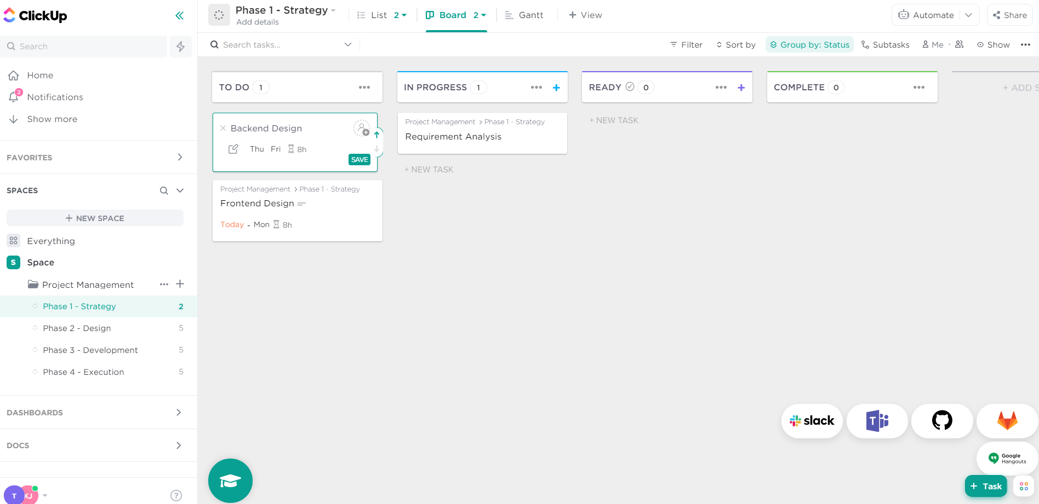
Agile Work Planning Tool
Use the click up app to track your project status and collaborate among team members.
One of the team member must be a scrum master for this sprint. Choose a person from the team.
Include the mentor also as a team member in the project.
Use the below link
https://app.clickup.com/

Slide 8
Evaluation Guidelines
Style Guidelines – Use any of the frontend technologies like HTML, CSS, Bootstrap, Angular Material etc.
Frontend Design – Build modular, reusable and smart components
Backend Design – Create the design patterns of microservices.
Testing – Test the layers of microservices and E2E testing.
Database – Model the database.
Containerization – Use of the docker compose tool..
Engineering Practices – Follow practices that ensure good code quality.

